Slide 1
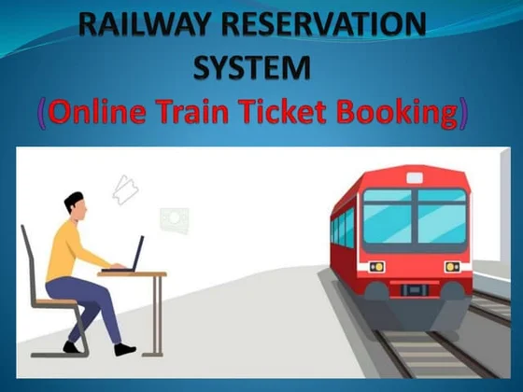
Presented By: Shweta Gaikwad
Batch : T208

Slide 2
ABSTRACT
The main purpose of maintaining database for Railway Reservation System is to reduce the manual errors involved in the booking and canceling of tickets and make it convenient for the customers and providers to maintain the data about their customers and also about the seats available at them.
Due to automation many loopholes that exist in the manual maintenance of the records can be removed.
The speed of obtaining and processing the data will be fast. At present we proposed IRCTC system that helps clients to make various enquiries about trains between stations, book ticket and all

Slide 3
INTRODUCTION
Database is an organized collection of data.
A DBMS makes it possible for end-users to create, read, update and delete data in a database.
The DBMS essentially serves as an interface between the database and end-users or application programs, ensuring that data is consistently organized and remains easily accessible.
It provide concurrency, security, data integrity, and uniform administration procedures.

Slide 4
PROJECT DESCRIPTION
The Project is creating the database about Railway Reservation System
The Railway Reservation System facilitates:
The passengers to enquire about the trains available on the basis of destination
Booking and cancellation of tickets
Enquire about the status of the booked ticket
The aim of case study is to design and develop a database maintaining the records of different trains, Train status, and users.
The record of train includes its number, name, description,capacity,time, destination

Slide 5
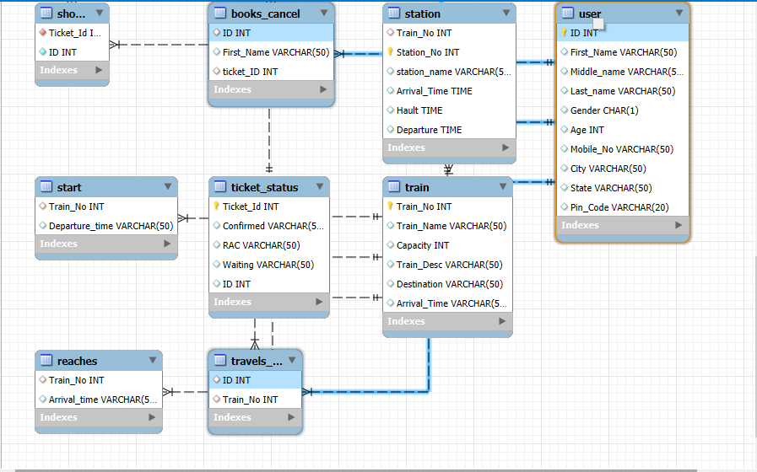
ER Diagram
This diagram shows Relation between User, Train,Station,Book_Cancel, travel_in

Slide 6
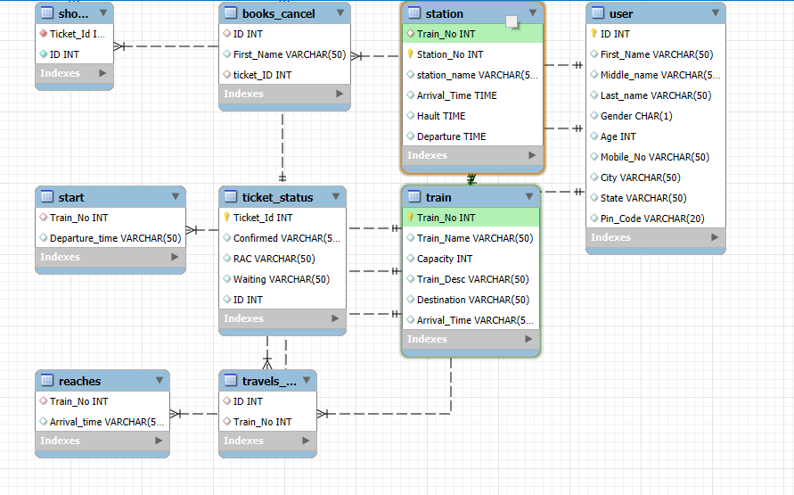
This diagram shows Relation between Train and station (many to many)

Slide 7
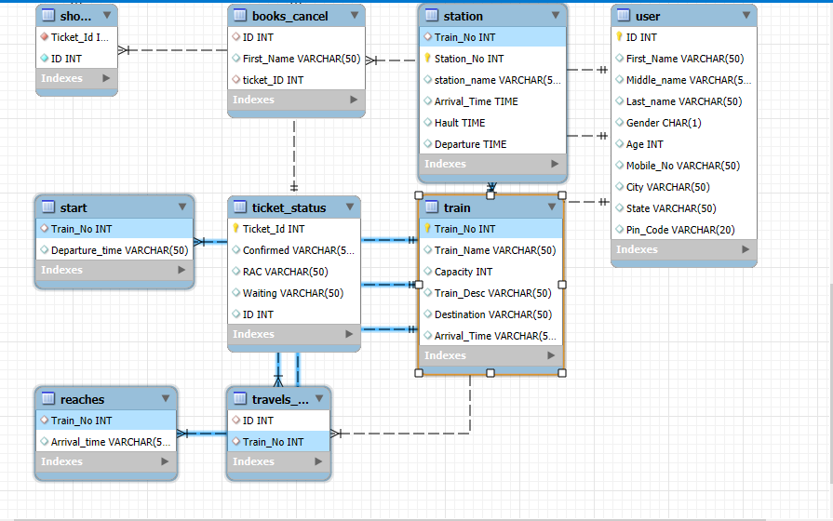
This diagram shows Relation between Train, ticket_status, travel_in,start, reaches (one to one) and relation between train and station is (one to many)

Slide 8
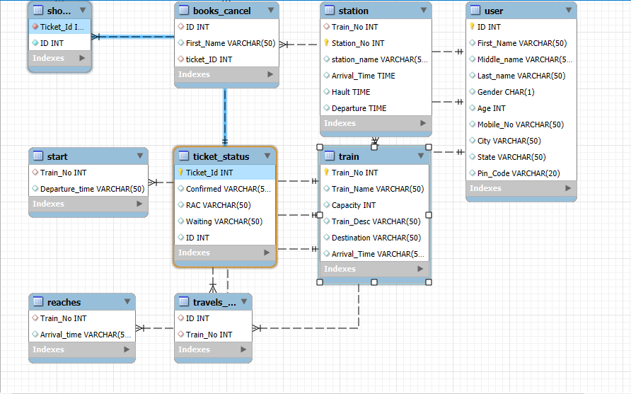

Slide 9
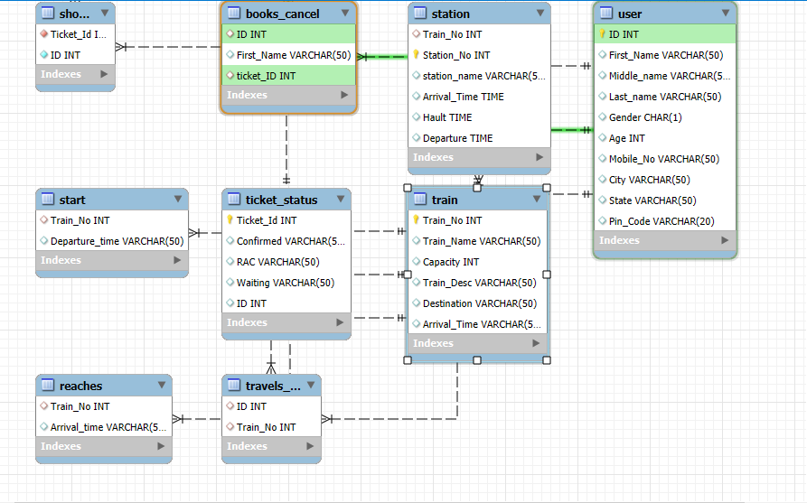

Slide 10
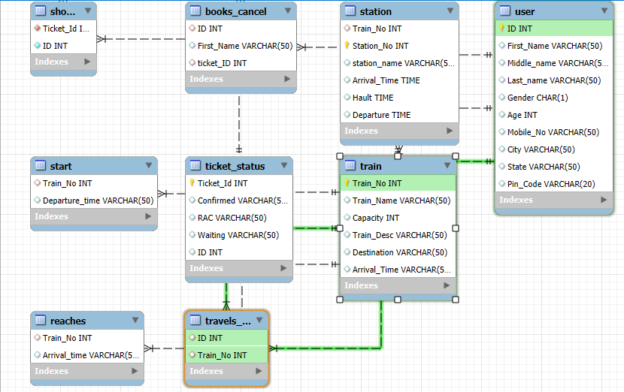

Slide 11
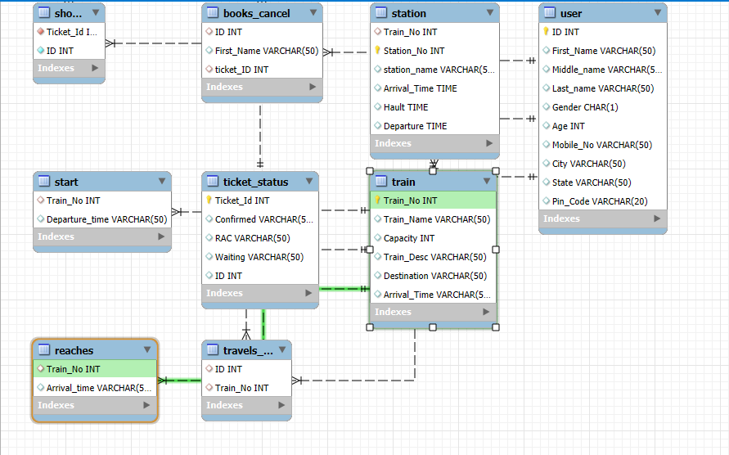

Slide 12
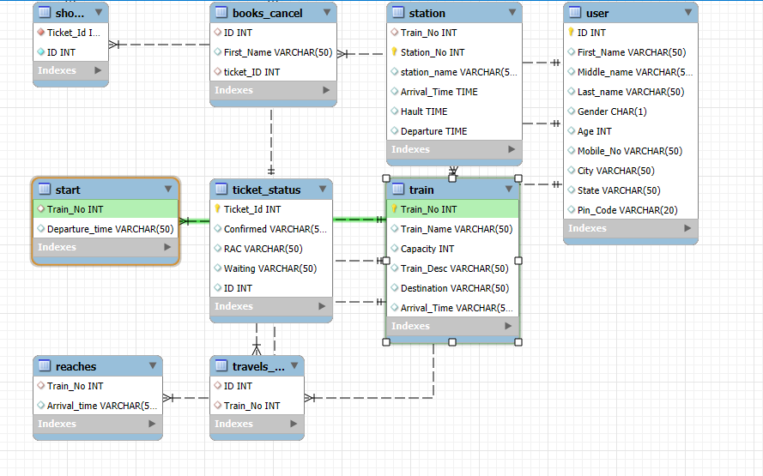

Slide 13
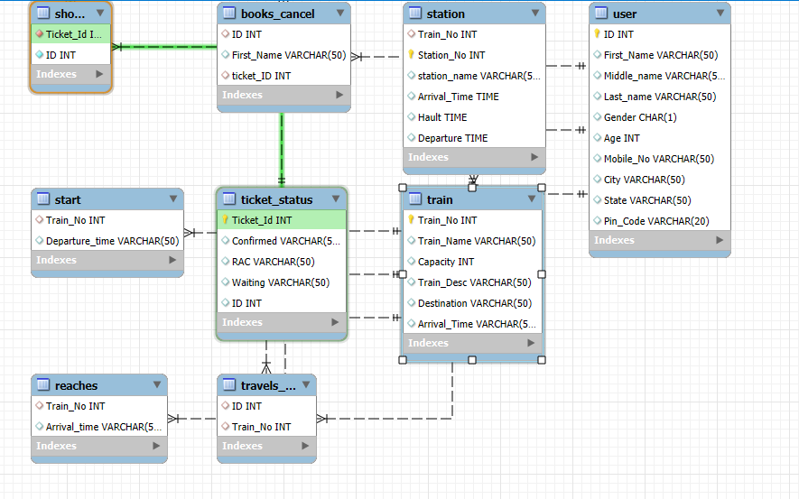

Slide 14
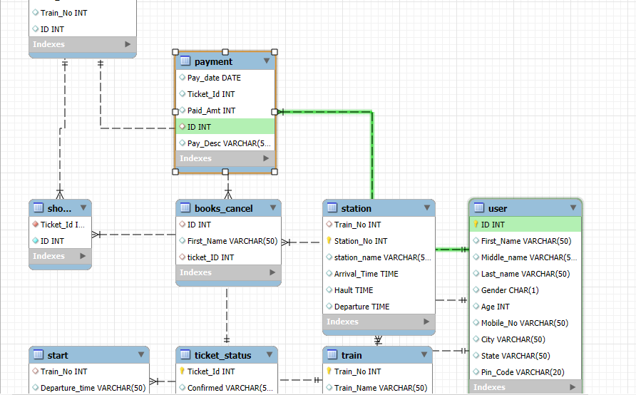

Slide 15
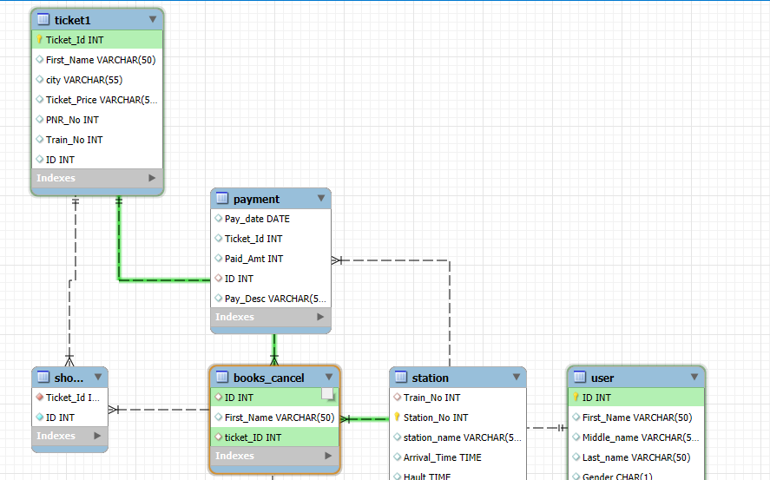

Slide 16
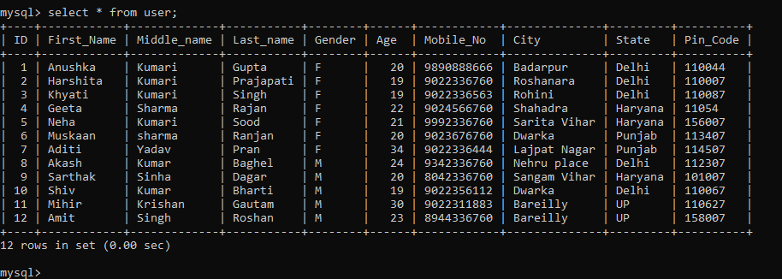
Table 1: create user Table: it shows user information:
Create table User( ID int primary key, First_Name varchar(50) , Middle_name varchar(50), Last_name varchar(50), Gender char, Age int, Mobile_No varchar(50), City varchar(50), State varchar(50), Pin_Code varchar(20));

Slide 17
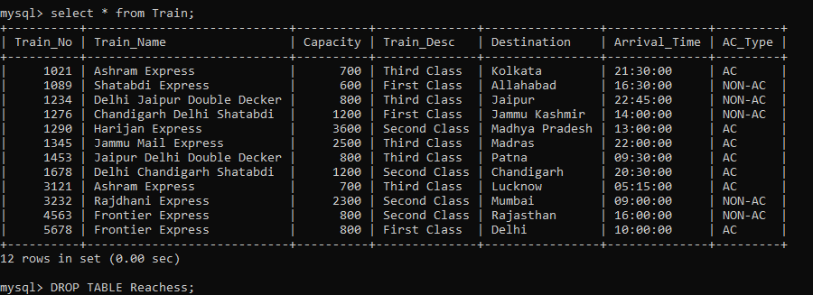
Table 2: create train table: it include train related information
Create table Train( Train_No int primary key, Train_Name varchar(50), Capacity int, Train_Desc Varchar(50), Destination varchar(50), Arrival_Time varchar(50) );

Slide 18
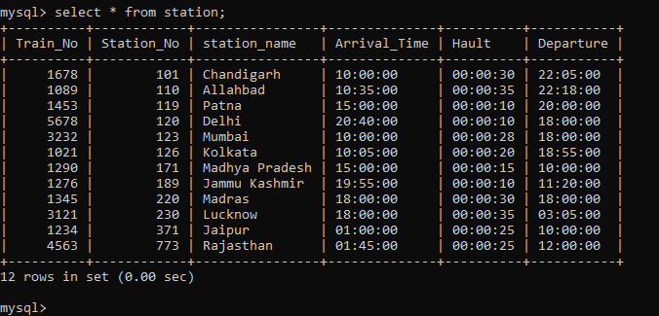
Table 3: create station table: it shows station information
Create table Station( Train_No int, Station_No int primary key,station_name varchar(50), Arrival_Time time, Hault time, Departure time , constraint train_no_fk foreign key(Train_No) references Train(Train_no));

Slide 19
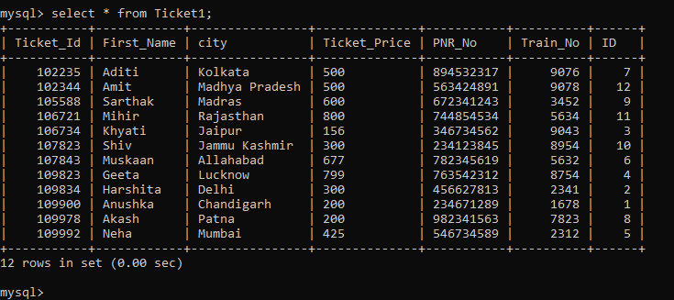
Table 4: create ticket table : it shows ticket information
Create table Ticket1( Ticket_Id int primary key, First_Name varchar(50),city varchar(55), Ticket_Price varchar(50), PNR_No int , Train_No int, ID int );

Slide 20
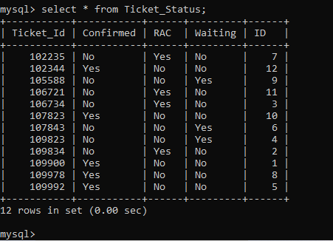
Table 5: create Ticket Status
Create table Ticket_Status ( Ticket_Id int primary key, Confirmed varchar(50), RAC varchar(50), Waiting varchar(50) , ID int);

Slide 21
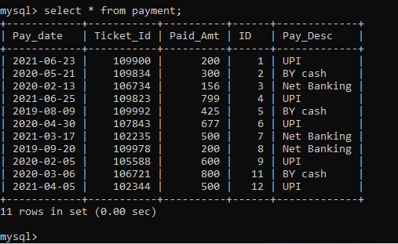
Table 6: Payment table
Create table Payment ( Pay_date date, Ticket_Id int, Paid_Amt int, ID int, Pay_Desc Varchar(50),constraint id_paytable_fk foreign key(ID) references User(ID) );

Slide 22
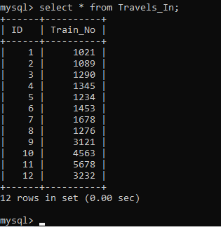
Table 7: Traveling Details
Create table Travels_In ( ID int , Train_No Int , Constraint travel_in_Id foreign key(ID) references User(ID), Constraint travel_in_tainno foreign key(Train_No) references Train(Train_No) );

Slide 23
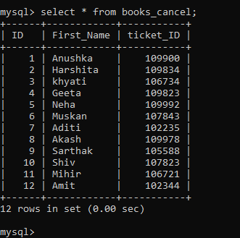
Table 8 : Book cancel ticket status
Create table Books_Cancel( ID int ,First_Name varchar(50),ticket_ID int, Constraint bkcl_idfk foreign key (ID) references User(ID), Constraint bkclticket_idfk foreign key (ticket_ID) references Ticket1(Ticket_Id));

Slide 24
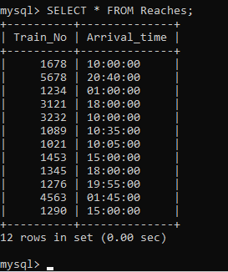
Table 9 : Train reaches details
Create table Reaches ( Train_No int , Arrival time varchar(50), Constraint reach_train_no_fk foreign key(train_no) references Train(train_no) );

Slide 25
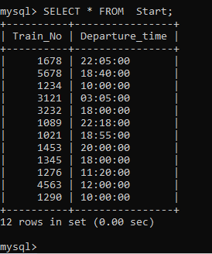
Table 10: train origin information , from where train is start
Create table Start (Train_No int , Departure_time varchar(50), Constraint start_trainno_fk foreign key(train_no) references Train(train_no) );

Slide 26
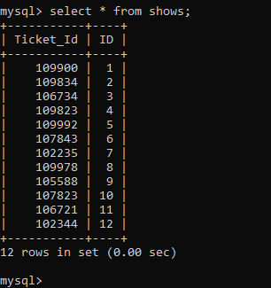
Table 11 :shows tables provide information about ticket
Create table Shows (Ticket_Id int NOT NULL, ID int NOT NULL, Constraint shows_tkid foreign key (Ticket_Id) references Ticket1(Ticket_Id), Constraint show_tkstatus_idfk foreign key(Ticket_Id) references Ticket_Status( ticket_Id) );

Slide 27
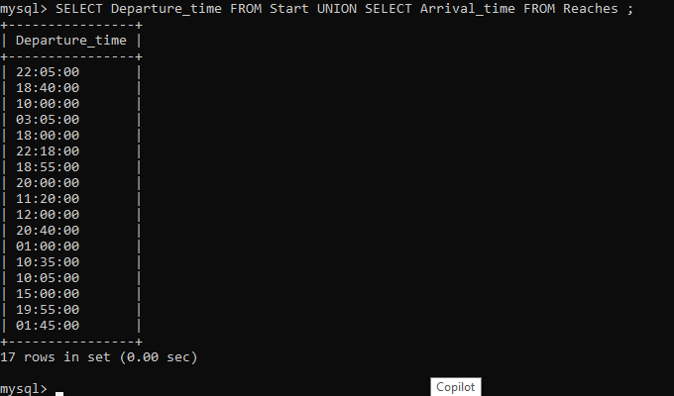
Total journey time : UNION operation
SELECT Departure_time FROM Start
UNION
SELECT Arrival_time FROM Reaches ;

Slide 28
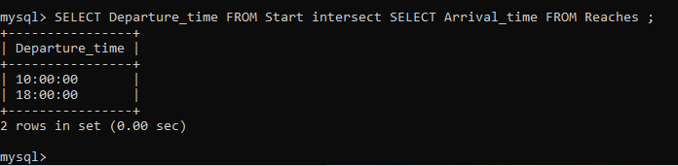
Same time required for journey : INTERSECT operation
SELECT Departure_time FROM Start
INTERSECT
SELECT Arrival_time FROM Reaches ;

Slide 29
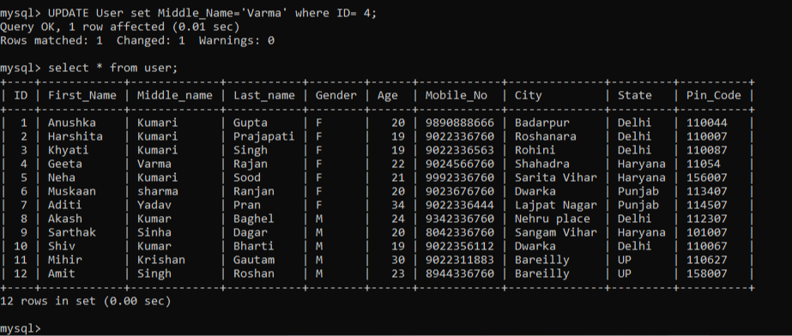
UPDATE Operation
UPDATE User set Middle_Name='Sharma' where ID= 4;

Slide 30
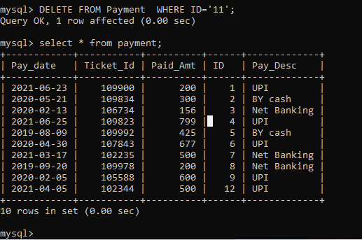
Delete Operation:
DELETE FROM Payment WHERE ID='10';SELECT * FROM Payment;

Slide 31
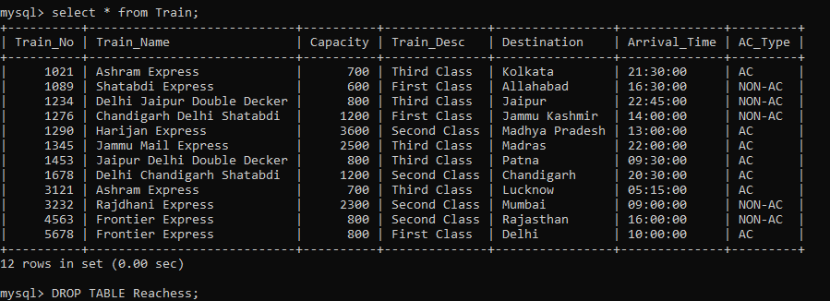
Alter a Table : Add column in existing table
ALTER Table Train ADD COLUMN AC_Type Varchar(50);

Slide 32
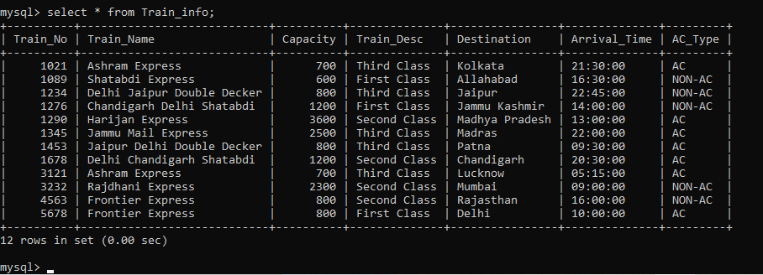
Operation : Rename Tables
ALTER TABLE Train RENAME Train_Info;
select * from Train_Info;

Slide 33
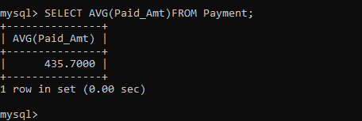
Simple Queries with Aggregate functions.
1.Average
SELECT
AVG(Paid_Amt)
FROM Payment;

Slide 34
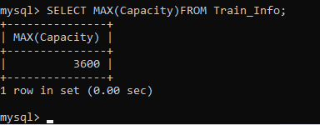
2. Maximum
SELECT
MAX(Capacity)
FROM Train_Info;

Slide 35
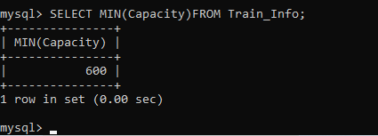
3.Minimum
SELECT
MIN(Capacity)
FROM Train_Info;

Slide 36
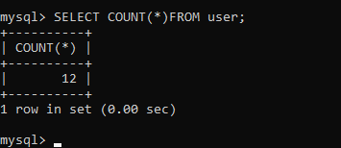
4. Count:
SELECT
COUNT(*)
FROM user;

Slide 37
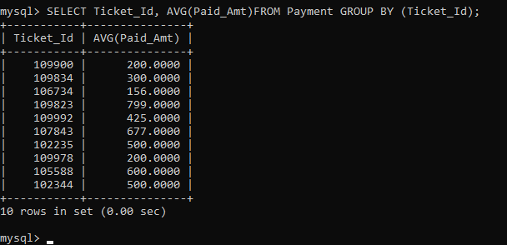
Queries with Aggregate functions(group by and having clause):
It shows the average amount for each ticket id
SELECT
Ticket_Id, AVG(Paid_Amt)
FROM Payment
GROUP BY Ticket_Id;

Slide 38
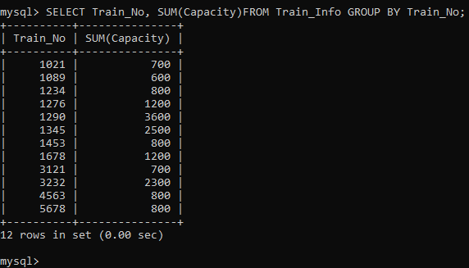
It shows the total capacity according to each train
SELECT Train_No, SUM(Capacity)
FROM Train_Info
GROUP BY Train_No;

Slide 39
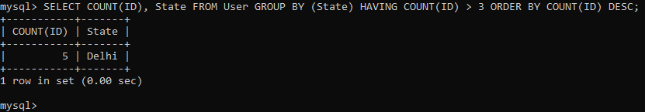
It shows state of user whose count Id is more than 3
SELECT COUNT(ID), State FROM User
GROUP BY State
HAVING COUNT(ID) > 3
ORDER BY COUNT(ID) DESC;

Slide 40
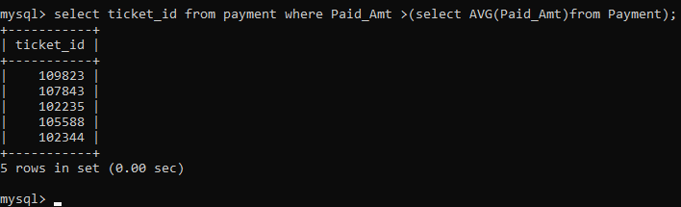
Operation subquery:
select ticket_id from payment where Paid_Amt >(select AVG(Paid_Amt)from Payment);

Slide 41
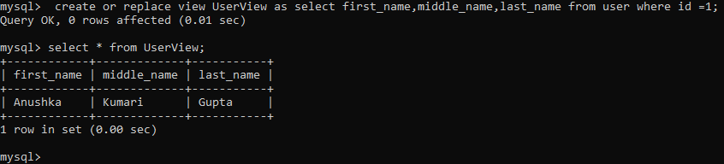
VIEW Operation:
create or replace view UserView as
select first_name,middle_name,last_name from user where id =1;
select * from UserView;

Slide 42


